Slide 1
Park Design Proposal
By: Group2

Slide 2
Task
Design a park with the following features:
Children’s area with blue swings
3 mile track around perimeter (color change every .25 miles)
Dog park
Forest and lots of trees throughout
Skate park
Tennis court
Basketball court
Parking around perimeter
Well grassed
Picnic area

Slide 3
How are we solving it
We decided to have an area which has all the amenities in close proximity.
Built with best in class materials and design with a customer first approach.
We do cater to all ages and mentalities.
One place where you can meet people from the city and have peace of mind
We designed world class courts and running tracks.
The plants we used also have medicinal value

Slide 4
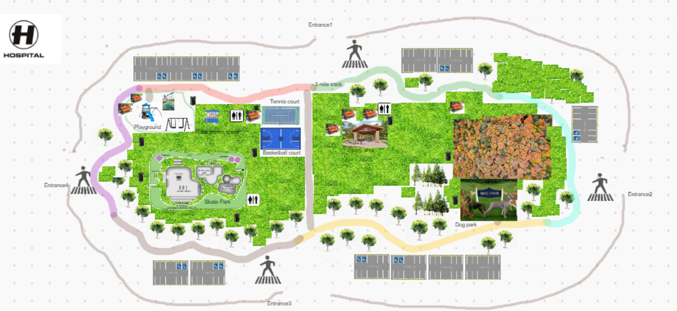
https://awwapp.com/b/ukahhd31f2bjo/

Slide 5
How’s it better and efficient
Provide a place where people can be more active and healthier.
Help children learn and improve social skills
Build a strong community relationship
Promote clean air with sufficient trees

Slide 6
Thank you!

